Slide 1





Noida Institute of Engineering and Technology, Greater Noida
PREDICTIVE ANALYTICS
Unit: 3
Non-Linear Regression
Mr. Sovers Singh Bisht
Assistant Professor
DS-DEPT
NIET
B-Tech 5TH Sem
ONLINE & Offline (Sec A, B)

Slide 2

Noida Institute of Engineering and Technology, Greater Noida
Mr. Sovers Singh Bisht
Dep. HOD (Data Science)
B.Tech, M.Tech
PH.D (P) in CSE ..
Area of Expertise: Data Science, Big Data Analytics
& Cloud Computing.

Slide 3

Evaluation Scheme
PROGRAM ELECTIVES BUCKET
DS
 | Data Analytics | Full Stack Development | Mobility Management | CRM-RPA
Program Elective 1 | Predictive Analytics | Python Web Development with Django | Mobile Application Development | CRM Fundamentals
Program Elective 2 | Web Technologies | Design Patterns | Development in Swift Fundamentals | CRM Administration
Program Elective 3 | Programming for Data Analytics | Advanced Java Programming | Development in Swift Explorations and Data Collections | CRM Development
Program Elective 4 | Social Media Analytics | Web Development using MEAN Stack | Augmented Reality and Virtual Reality | Robotics Process Automation (RPA)
Program Elective 5 | Natural language Processing | Web Development using MERN Stack | Game Programming | Robotics Process Automation (RPA) Implementation

Slide 4
Evaluation Scheme
DATA ANALYTICS (AI/AIML)
SUBJECTS | CREDITS | ELECTIVE | SEMESTER
Predictive Analytics | 3 | I | 5th
Web Technologies | 3 | II | 5th
Programming for Data Analytics | 3 | III | 6th
Social Media Analytics | 3 | IV | 6th
Natural language Processing | 3 | V | 7th

Slide 5

Evaluation Scheme
B.Tech. (Data Analytics-DS)
Elective- I
5th SEMESTER
PREDICTIVE ANALYTICS
L T P | Credits
3 – 0 – 0 | 3

Slide 6
Course Contents / Syllabus
B. TECH. THIRD YEAR (ELECTIVE-I)
Course code |  |  | L T P | Credits
Course title |  | PREDICTIVE ANALYTICS | 3 0 0 | 3
Course objective:
To be able to solve complex problems that require discovering hidden patterns in the data and a deep understanding of intricate relationships between a large number of interdependent variables tasked with collecting, analyzing, and interpreting large amounts of data.
Pre-requisites: Basic concepts of Machine learning Algorithms
Course Contents / Syllabus
UNIT-I | LINEAR REGRESSION |  |  | 8 HOURS
Introduction to Predictive Analytics, Regression basics: Relationship between attributes using Covariance and Correlation, Relationship, between multiple variables: Regression (Linear, Multivariate) in prediction, Residual Analysis Identifying significant features, feature reduction using AIC, multi-collinearity, Non-normality and Hetero scedasticity, Hypothesis testing of Regression Model, Confidence intervals of Slope, R-square and goodness of fit, Influential Observations – Leverage.
UNIT-II | MULTIPLE LINEAR REGRESSION |  |  | 8 HOURS
Polynomial Regression, Regularization methods, Lasso, Ridge and Elastic nets, Categorical Variables in Regression.
UNIT-III | NON-LINEAR REGRESSION |  |  | 8 HOURS
Logit function and interpretation, Types of error measures (ROCR), Logistic Regression in classification.

Slide 7
Course Contents / Syllabus
UNIT-IV |  | FORECASTING MODELS |  |  | 8 HOURS
Trend analysis, Cyclical and Seasonal analysis, smoothing, Moving averages, Box-Jenkins, Holt-winters, Autocorrelation, ARIMA, Examples: Applications of Time Series in financial markets.
UNIT-V |  | FEATURE ENGINEERING |  |  | 8 HOURS
Data Science Vs. Machine Learning, Exploratory Data Analysis, Feature Encoding, Imputation Feature Scaling, Determining correlation, Feature selection, Feature extraction.
Course outcome: After completion of this course students will be able to
CO 1 | Apply specific statistical and regression analysis methods applicable to predictive analytics to identify new trends and patterns, uncover relationships, create forecasts, predict likelihoods, and test predictive hypotheses. | Apply specific statistical and regression analysis methods applicable to predictive analytics to identify new trends and patterns, uncover relationships, create forecasts, predict likelihoods, and test predictive hypotheses. |  |  |  | K1, K2
CO 2 | Learn how to select the appropriate method for predictive analysis, and how to build effective predictive models. | Learn how to select the appropriate method for predictive analysis, and how to build effective predictive models. |  |  |  | K2
CO 3 | Learn how to evaluate the soundness, appropriateness and validity of their models and how to interpret and report on results for a management audience. | K3
CO 4 | Apply predictive analytics approaches on diverse business cases and scenarios. | K4
CO 5 | Understand the process of formulating business objectives, data selection/collection, preparation and process to successfully design, build, evaluate and implement predictive models for a various business application. | K5, K6

Slide 8
External Links as per Syllabus
NPTEL/ Youtube/ Faculty Video Link:
Unit 1 | Predictive Analytics Tutorial | Linear Regression in Python | Logistic Regression | Great Learning - YouTube Multiple Regression Analysis: Hypothesis Tests - YouTube Mod-06 Lec-28 Goodness of Fit - YouTube
Unit 2 | Multiple Linear Regression Model - YouTube Regularization In Machine Learning | Regularization Example | Machine Learning Tutorial |Simplilearn - YouTube Implementing Ridge, Lasso and Elastic Net in Python from Scratch (Mathematics Explained!) - YouTube
Unit 3 | Non Linear Regression | Data Science | Econometrics - YouTube Machine Learning Tutorial Python - 8: Logistic Regression (Binary Classification) - YouTube
Unit 4 | Time Series Talk : ARIMA Model - YouTube Holt winters Model, Easiest Times series Model. Additive multiplicative trend and seasonality - YouTube Time Series Analysis in Python | Time Series Forecasting | Data Science with Python | Edureka - YouTube
Unit 5 | Data Science vs Machine Learning – What’s The Difference? | Data Science Course | Edureka - YouTube Exploratory Data Analysis (EDA) Using Python | Python Data Analysis | Python Training | Edureka - YouTube Feature Selection In Machine Learning | Feature Selection Techniques With Examples | Simplilearn - YouTube

Slide 9
Branch wise Applications
Predictive analytics is a branch of advanced analytics that makes predictions about future outcomes using historical data combined with statistical modeling, data mining techniques and machine learning. Companies employ predictive analytics to find patterns in this data to identify risks and opportunities.
Predictive analytics are used to determine customer responses or purchases, as well as promote cross-sell opportunities. Predictive models help businesses attract, retain and grow their most profitable customers. Improving operations. Many companies use predictive models to forecast inventory and manage resources.
Predictive analytics uses statistics and modeling techniques to determine future performance.
Industries and disciplines, such as insurance and marketing, use predictive techniques to make important decisions.
Predictive models help make weather forecasts, develop video games, translate voice-to-text messages, customer service decisions, and develop investment portfolios.
People often confuse predictive analytics with machine learning even though the two are different disciplines.
Types of predictive models include decision trees, regression, and neural networks.

Slide 10
Course Objective
The objective of this course is -
To be able to solve complex problems that require discovering hidden patterns in the data and a deep understanding of intricate relationships between a large number of interdependent variables tasked with collecting, analyzing, and interpreting large amounts of data.

Slide 11


Course Outcomes

Slide 12
Program Outcomes
Engineering Graduates will be able to Understand:
1. Engineering knowledge
2. Problem analysis
3. Design/development of solutions
4. Conduct investigations of complex
5. Modern tool usage
6. The engineer and society
7. Environment and sustainability
8. Ethics
9. Individual and team work
10. Communication
11. Project management and finance
12. Life-long learning

Slide 13
CO-PO Mapping

Slide 14
Program Specific Outcomes (PSOs)
PSO’s
At the end of the program, the student will be able to-
PSO 1: Analyse, design and develop solutions by applying fundamental concepts of Data Science
PSO 2: Apply technical knowledge while using modern tools and technologies for solving complex problems.
PSO 3: Collaborate different fields of science and technology with right attitude, to work as an individual or as a team, demonstrating professional ethics for the well-being of society

Slide 15
COs and PSOs Mapping

Slide 16
Program Educational Objectives (PEOs)
PEO’s
The graduates of B.Tech Data Science program will-
PEO1: Solve real time complex problems and adapt to technological changes with the ability of lifelong learning.
PEO2: Work as data scientists ,entrepreneurs and bureaucrats for goodwill of the society and pursue higher education.
PEO3: Exhibit professional ethics and moral values with good leadership qualities and effective interpersonal skills

Slide 17
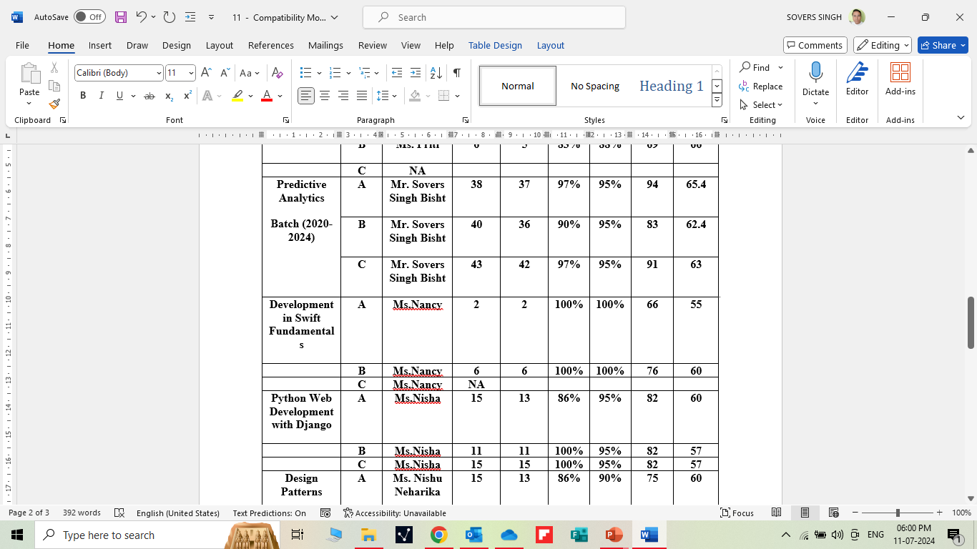
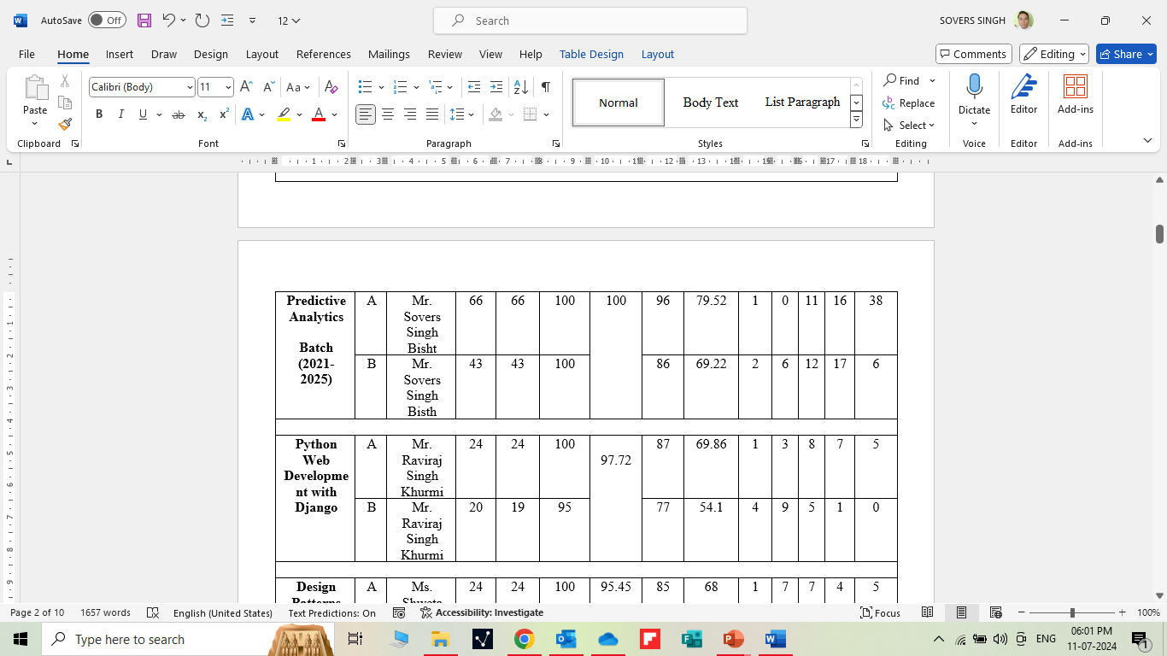
RESULT ANALYSIS

Slide 18

Question Paper Template

Slide 19
Question Paper Template
 |  | SECTION – A |  | CO
 | Attempt all parts- |  | [10×1=10]
 | 1-a. | Question- | (1)
 | 1-b. | Question- | (1)
 | 1-c. | Question- | (1)
 | 1-d. | Question- | (1)
 | 1-e. | Question- | (1)
 | 1-f. | Question- | (1)
 | 1-g. | Question- | (1)
 | 1-h. | Question- | (1)
 | 1-i. | Question- | (1)
 | 1-j. | Question- | (1)
2. | Attempt all parts- |  | [5×2=10] | CO
 | 2-a. | Question- | (2)
 | 2-b. | Question- | (2)
 | 2-c. | Question- | (2)
 | 2-d. | Question- | (2)
 | 2-e. | Question- | (2)
SECTION – B |  |  |  | CO
3. | Answer any five of the following- |  | [5×6=30]
 | 3-a. | Question- | (6)
 | 3-b. | Question- | (6)
 | 3-c. | Question- | (6)
 | 3-d. | Question- | (6)
 | 3-e. | Question- | (6)
 | 3-f. | Question- | (6)
 | 3-g. | Question- | (6)
SECTION – C |  |  |  | CO
4 | Answer any one of the following- |  | [5×10=50]
 | 4-a. | Question- | (10)
 | 4-b. | Question- | (10)
5. | Answer any one of the following-
 | 5-a. | Question- | (10)
 | 5-b. | Question- | (10)
6. | Answer any one of the following-
 | 6-a. | Question- | (10)
 | 6-b. | Question- | (10)
7. | Answer any one of the following-
 | 7-a. | Question- | (10)
 | 7-b. | Question- | (10)
8. | Answer any one of the following-
 | 8-a. | Question- | (10)
 | 8-b. | Question- | (10)

Slide 20
Prerequisite and Recap
Prerequisites:
Linux/ Windows operating system.
Knowledge of basic descriptive statistics and machine learning.
Java & R Studio.
MS Office 2019 and Above.
Programming Languages (Python)
Recap:
Discussion about Data Science Environments.

Slide 21
Brief Intro of Subject with video
Predictive analytics is a form of technology that makes predictions about certain unknowns in the future. It draws on a series of techniques to make these determinations, including artificial intelligence (AI), data mining, machine learning, modeling, and statistics.
For instance, data mining involves the analysis of large sets of data to detect patterns from it. Text analysis does the same, except for large blocks of text.
Predictive models are used for all kinds of applications, including:
Weather forecasts
Creating video games
Translating voice to text for mobile phone messaging
Customer service
Investment portfolio development
https://www.youtube.com/watch?v=4y6fUC56KPw
https://www.youtube.com/watch?v=JOArz7wggkQ

Slide 22
CONTENTS
Non-Linear Regression:
Logit function and interpretation
Types of error measures (ROCR)
Logistic Regression in classification.

Slide 23
Unit Objective
The objective of the Unit 3 is :
Overall, a nonlinear regression model is used to accommodate different mean functions, even though it is less flexible than a linear regression model.
Some of its advantages include predictability, parsimony, and interpretability.
Financial forecasting is one way that a nonlinear regression can be applied.
The nonlinear model provides a better fit because it is both unbiased and produces smaller residuals.
Nonlinear regression is a powerful alternative to linear regression but there are a few drawbacks.
Fortunately, it's not difficult to try linear regression first.

Slide 24
Logit function and interpretation
Objective:
In this topic we learn about logistic regression, a logit transformation is applied on the odds—that is, the probability of success divided by the probability of failure. This is also commonly known as the log odds, or the natural logarithm of odds, and this logistic function is represented by the following formulas: Logit(pi) = 1/(1+ exp(-pi))
Recap:
Revision of basic statistical approaches.

Slide 25
CONTENTS
1. Logit function and interpretation
Why use logistic regression?
There are many important research topics for which the dependent variable is "limited" (discrete not continuous). Researchers often want to analyze whether some event occurred or not, such as voting, participation in a public program, business success or failure, morbidity, mortality, a hurricane and etc.
Binary logistic regression is a type of regression analysis where the dependent variable is a dummy variable (coded 0, 1).

Slide 26
CONTENTS
A data set appropriate for logistic regression might look like this:
Descriptive Statistics
Variable | N | Minimum | Maximum | Mean | Std. Deviation
YES | 122 | .00 | 1.00 | .6393 | .4822
BAG | 122 | .00 | 7.00 | 1.5082 | 1.8464
COST | 122 | 9.00 | 953.00 | 416.5492 | 285.4320
INCOME | 122 | 5000.00 | 85000.00 | 38073.7705 | 18463.1274
Valid N (listwise) | 122
*This data is from a U.S. Department of the Interior survey (conducted by U.S. Bureau of the Census) which looks at a yes/no response to a question about the "willingness to pay" higher travel costs for deer hunting trips in North Carolina (a more complete description of this data can be found here).

Slide 27
CONTENTS
The linear probability model
"Why shouldn't I just use ordinary least squares?" Good question. Consider the linear probability (LP) model:
Y = a + BX + e
where
Y is a dummy dependent variable, =1 if event happens, =0 if event doesn't happen,
a is the coefficient on the constant term,
B is the coefficient(s) on the independent variable(s),
X is the independent variable(s), and
e is the error term.

Slide 28
CONTENTS
Use of the LP model generally gives you the correct answers in terms of the sign and significance level of the coefficients. The predicted probabilities from the model are usually where we run into trouble. There are 3 problems with using the LP model:
The error terms are heteroskedastic (heteroskedasticity occurs when the variance of the dependent variable is different with different values of the independent variables): var(e)= p(1-p), where p is the probability that EVENT=1. Since P depends on X the "classical regression assumption" that the error term does not depend on the Xs is violated.
e is not normally distributed because P takes on only two values, violating another "classical regression assumption"
The predicted probabilities can be greater than 1 or less than 0 which can be a problem if the predicted values are used in a subsequent analysis. Some people try to
solve this problem by setting probabilities that are greater than (less than) 1 (0) to be equal to 1 (0). This amounts to an interpretation that a high probability of the Event (Nonevent) occuring is considered a sure thing.

Slide 29
CONTENTS
The logistic regression model
The "logit" model solves these problems: ln[p/(1-p)] = a + BX + e or
[p/(1-p)] = exp(a + BX + e) where:
ln is the natural logarithm, log_{exp}, where exp=2.71828…
p is the probability that the event Y occurs, p(Y=1)
p/(1-p) is the "odds ratio"
ln[p/(1-p)] is the log odds ratio, or "logit"
all other components of the model are the same.

Slide 30
CONTENTS
The logistic regression model is simply a non-linear transformation of the linear regression. The "logistic" distribution is an S-shaped distribution function which is similar to the standard-normal distribution (which results in a probit regression model) but easier to work with in most applications (the probabilities are easier to calculate). The logit distribution constrains the estimated probabilities to lie between 0 and 1.
For instance, the estimated probability is: p = 1/[1 + exp(-a - BX)]
With this functional form:
if you let a + BX =0, then p = .50
as a + BX gets really big, p approaches 1
as a + BX gets really small, p approaches 0.
A graphical comparison of the linear probability and logistic regression models is illustrated here.

Slide 31
CONTENTS
Interpreting logit coefficients
The estimated coefficients must be interpreted with care. Instead of the slope coefficients (B) being the rate of change in Y (the dependent variables) as X changes (as in the LP model or OLS regression), now the slope coefficient is interpreted as the rate of change in the "log odds" as X changes. This explanation is not very intuitive. It is possible to compute the more intuitive "marginal effect" of a continuous independent variable on the probability. The marginal effect is
dp/dB = f(BX)B
where f(.) is the density function of the cumulative probability distribution function [F(BX), which ranges from 0 to 1]. The marginal effects depend on the values of the independent variables, so, it is often useful to evaluate the marginal effects at the means of the independent variables. (SPSS doesn't have an option for the marginal effects. If you need to compute marginal effects you can use the LIMDEP statistical package which is available on the academic mainframe.)

Slide 32
CONTENTS
An interpretation of the logit coefficient which is usually more intuitive (especially for dummy independent variables) is the "odds ratio"-- expB is the effect of the independent variable on the "odds ratio" [the odds ratio is the probability of the event divided by the probability of the nonevent]. For example, if expB₃ =2, then a one unit change in X₃ would make the event twice as likely (.67/.33) to occur. Odds ratios equal to 1 mean that there is a 50/50 chance that the event will occur with a small change in the independent variable. Negative coefficients lead to odds ratios less than one: if expB₂ =.67, then a one unit change in X₂ leads to the event being less likely (.40/.60) to occur. {Odds ratios less than 1 (negative coefficients) tend to be harder to interpret than odds ratios greater than one(positive coefficients).} Note that odds ratios for continuous independent variables tend to be close to one, this does NOT suggest that the coefficients are insignificant. Use the Wald statistic (see below) to test for statistical significance.

Slide 33
CONTENTS
Estimation by maximum likelihood
[For those of you who just NEED to know ...] Maximum likelihood estimation (MLE) is a statistical method for estimating the coefficients of a model. MLE is usually used as an alternative to non-linear least squares for nonlinear equations.
The likelihood function (L) measures the probability of observing the particular set of dependent variable values (p₁, p₂, ..., p_{n}) that occur in the sample. It is written as the probability of the product of the dependent variables:
L = Prob (p₁* p₂* * * p_{n})
The higher the likelihood function, the higher the probability of observing the ps in the sample. MLE involves finding the coeffients (a, B) that makes the log of the likelihood function (LL < 0) as large as possible or -2 times the log of the likelihood function (-2LL) as small as possible. The maximum likelihood estimates solve the following condition:
{Y - p(Y=1)}X_{i} = 0, summed over all observations
{or something like that ... }

Slide 34
CONTENTS
Hypothesis testing
Testing the hypothesis that a coefficient on an independent variable is significantly different from zero is similar to OLS models. The Wald statisitic for the B coefficient is:
Wald = [B/s.e._{B}]²
which is distributed chi-square with 1 degree of freedom. The Wald is simply the square of the (asymptotic) t-statistic.
The probability of a YES response from the data above was estimated with the logistic regression procedure in SPSS (click on "statistics," "regression," and "logistic"). The SPSS results look like this:

Slide 35
CONTENTS
Variables in the Equation
Variable | B | S.E. | Wald | df | Sig | R | Exp(B)
 | [1] | [2] | [3] |  | [4] | [5] | [6]
BAG | 0.2639 | 0.1239 | 4.5347 | 1 | 0.0332 | 0.1261 | 1.302
INCOME | 4.63E-07 | 1.07E-05 | 0.0019 | 1 | 0.9656 | 0 | 1
COST | -0.0018 | 0.0007 | 6.5254 | 1 | 0.0106 | -0.1684 | 0.9982
Constant | 0.9691 | 0.569 | 2.9005 | 1 | 0.0885
Notes:
[1] B is the estimated logit coefficient
[2] S.E. is the standard error of the coefficient [3] Wald = [B/S.E.]²
[4] "Sig" is the significance level of the coefficient: "the coefficient on BAG is significant at the .03 (97% confidence) level."
[5] The "Partial R" = sqrt{[(Wald-2)/(-2*LL(a)]}; see below for LL(a) [6] Exp(B) is the "odds ratio" of the individual coefficient.

Slide 36
CONTENTS
Evaluating the overall performance of the model
There are several statistics which can be used for comparing alternative models or evaluating the performance of a single model:
1. The model likelihood ratio (LR), or chi-square, statistic is LR[i] = -2[LL(a)- LL(a,B) ]
or as you are reading SPSS printout:
LR[i] = [-2 Log Likelihood (of beginning model)]
- [-2 Log Likelihood (of ending model)].
where the model LR statistic is distributed chi-square with i degrees of freedom, where i is the number of independent variables. The "unconstrained model", LL(a,B_{i}), is the log- likelihood function evaluated with all independent variables included and the "constrained model" is the log-likelihood function evaluated with only the constant included, LL(a).

Slide 37
CONTENTS
Use the Model Chi-Square statistic to determine if the overall model is statistically significant.
2. The "Percent Correct Predictions" statistic assumes that if the estimated p is greater than or equal to .5 then the event is expected to occur and not occur otherwise. By assigning these probabilities 0s and 1s the following table is constructed:
Classification Table for YES The Cut Value is .50
 |  | Predicted |  | % Correct
 |  | 0 | 1
Observed | 0 | 9 | 35 | 20.25%
 | 1 | 4 | 74 | 94.87%
Overall |  |  |  | 68.03%
the bigger the % Correct Predictions, the better the model.

Slide 38
CONTENTS
3. Most OLS researchers like the R² statistic. It is the proportion of the variance in the dependent variable which is explained by the variance in the independent variables. There is NO equivalent measure in logistic regression. However, there are several "Pseudo" R² statistics. One psuedo R² is the McFadden's-R² statistic (sometimes called the likelihood ratio index [LRI]):
McFadden's-R²= 1 - [LL(a,B)/LL(a)]
= 1 - [-2LL(a,B)/-2LL(a)]
where the R² is a scalar measure which varies between 0 and (somewhat close to) 1 much like the R² in a LP model. Expect your Pseudo R²s to be much less than what you would expect in LP model, however. Because the LRI depends on the ratio of the beginning and ending log- likelihood functions, it is very difficult to "maximize the R²" in logistic regression.
The Pseudo-R² in logistic regression is best used to compare different specifications of the same model. Don't try to compare models with different data sets with the Pseudo- R² [referees will yell at you ...].

Slide 39
CONTENTS
Other Pseudo-R² statistics are printed in SPSS output but [YIKES!] I can't figure out how these are calculated (even after consulting the manual and the SPSS discussion list)!?!
Source: SPSS Output
(-2)*Initial LL | [1] | 159.526
(-2)*Ending LL | [2] | 147.495
Goodness of Fit | [3] | 123.18
Cox & Snell-R^2 |  | 0.094
Nagelkerke-R^2 |  | 0.129
 | Chi-Square [4] | df | Significance
Model | 12.031 | 3 | 0.0073
Notes:
[1] LL(a) = 159.526/(-2) = -79.763
[2] LL(a,B) = 147.495/(-2) = -73.748
[3] GF = [Y - P(Y=1)]²/[Y - P(Y=1)]
[4] Chi-Square = -2[LL(a)-LL(a,B)] = 159.526 - 147.495
McFadden's-R² = 1- (147.495/159.526) = 0.075

Slide 40
Types of error measures (ROCR)
Objective:
In this topic we learn about ROCR is a package for evaluating and visualizing the performance of scoring classifiers in the statistical language R. It features over 25 performance measures that can be freely combined to create two-dimensional performance curves.
Recap:
Revision of basic statistical approaches.

Slide 41
CONTENTS
2. Types of error measures (ROCR)
ntroduction
ROCR (with obvious pronounciation) is an R package for evaluating and visualizing
classifier performance. It is…
…easy to use: adds only three new commands to R.
…flexible: integrates tightly with R’s built-in graphics facilities.
…powerful: Currently, 28 performance measures are implemented, which can be freely combined to form parametric curves such as ROC curves, precision/recall curves, or lift curves. Many options such as curve averaging (for cross-validation or bootstrap), augmenting the averaged curves by standard error bar or boxplots, labeling cutoffs to the curve, or coloring curves according to cutoff.

Slide 42
CONTENTS
Performance measures that ROCR knows:
Accuracy, error rate, true positive rate, false positive rate, true negative rate, false negative rate, sensitivity, specificity, recall, positive predictive value, negative predictive value, precision, fallout, miss, phi correlation coefficient, Matthews correlation coefficient, mutual information, chi square statistic, odds ratio, lift value, precision/recall F measure, ROC convex hull, area under the ROC curve, precision/recall break-even point, calibration error, mean cross-entropy, root mean squared error, SAR measure, expected cost, explicit cost.
ROCR features:
ROC curves, precision/recall plots, lift charts, cost curves, custom curves by freely selecting one performance measure for the x axis and one for the y axis, handling of data from cross- validation or bootstrapping, curve averaging (vertically, horizontally, or by threshold), standard error bars, box plots, curves that are color-coded by cutoff, printing threshold values on the curve, tight integration with Rs plotting facilities (making it easy to adjust plots or to combine multiple plots), fully customizable, easy to use (only 3 commands).

Slide 43
CONTENTS
Installation of ROCR
The most straightforward way to install and use ROCR is to install it from CRAN by starting R and using the install.packages function:
install.packages("ROCR")
Alternatively you can install it from command line using the tar ball like this:
R CMD INSTALL ROCR_*.tar.gz
Getting started
from within R …
library(ROCR) demo(ROCR) help(package=ROCR)
Examples
Using ROCR’s 3 commands to produce a simple ROC plot:
pred <- prediction(predictions, labels)
perf <- performance(pred, measure = "tpr", x.measure = "fpr") plot(perf, col=rainbow(10))

Slide 44
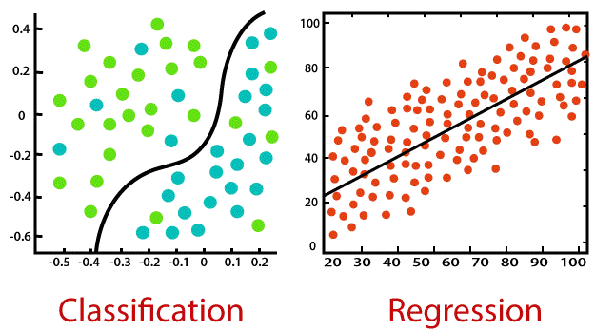
CONTENTS
Documentation
The Reference Manual found here
Slide deck for a tutorial talk (feel free to re-use for teaching, but please give appropriate credits and write us an email) [PPT]
A few pointers to the literature on classifier evaluation
3. Logistic Regression in classification
Logistic Regression comes under Supervised Learning. Supervised Learning is when the algorithm learns on a labeled dataset and analyses the training data. These labeled data sets have inputs and expected outputs.
Supervised learning can be further split into classification and regression.
Classification is about predicting a label, by identifying which category an object belongs to based on different parameters.
Regression is about predicting a continuous output, by finding the correlations between dependent and independent variables.

Slide 45
CONTENTS
What is Logistic Regression?
Logistic Regression is a statistical approach and a Machine Learning algorithm that is used for classification problems and is based on the concept of probability. It is used when the dependent variable (target) is categorical.
It is widely used when the classification problem at hand is binary; true or false, yes or no, etc. For example, it can be used to predict whether an email is spam (1) or not (0).
Logistics regression uses the sigmoid function to return the probability of a label.
Sigmoid Function
Sigmoid Function is a mathematical function used to map the predicted values to probabilities. The function has the ability to map any real value into another value within a range of 0 and 1.c

Slide 46
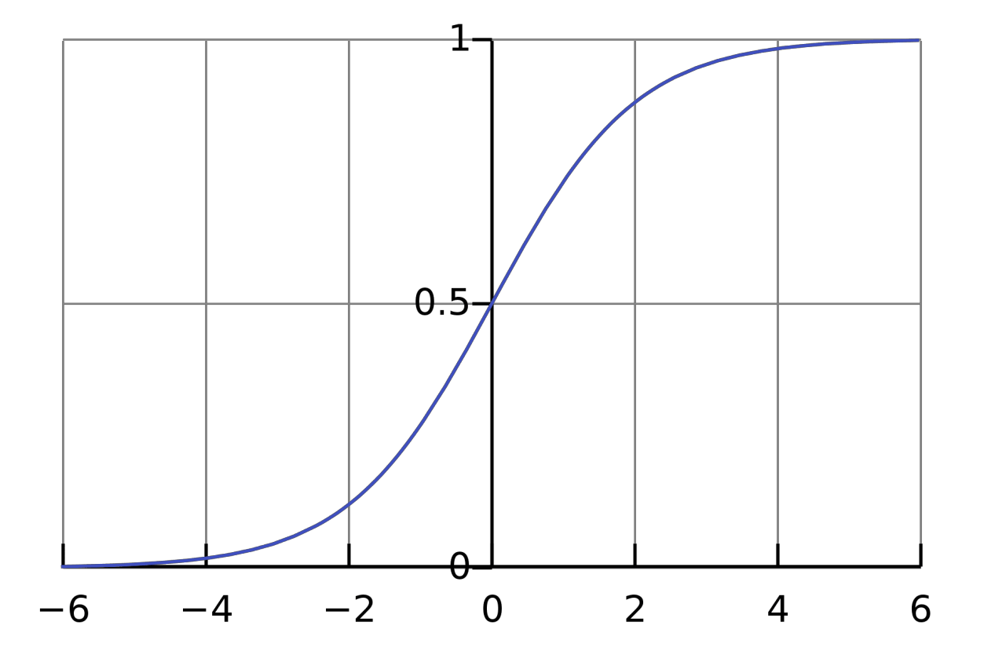
CONTENTS
Code:
def sigmoid(z):
return 1.0 / (1 + np.exp(-z))
The rule is that the value of the logistic regression must be between 0 and 1. Due to the limitations of it not being able to go beyond the value 1, on a graph it forms a curve in the form of an "S". This is an easy way to identify the Sigmoid function or the logistic function. In regards to Logistic Regression, the concept used is the threshold value. The threshold values help to define the probability of either 0 or 1. For example, values above the threshold value tend to 1, and a value below the threshold value tends to 0.

Slide 47
CONTENTS
Type of Logistic Regression
Binomial: This means that there can be only two possible types of the dependent variables, such as 0 or 1, Yes or No, etc.
Multinomial: This means that there can be 3 or more possible unordered types of the dependent variable, such as "cat", "dogs", or "sheep"
Ordinal: This means that there can be 3 or more possible ordered types of dependent variables, such as "low", "Medium", or "High".

Slide 48
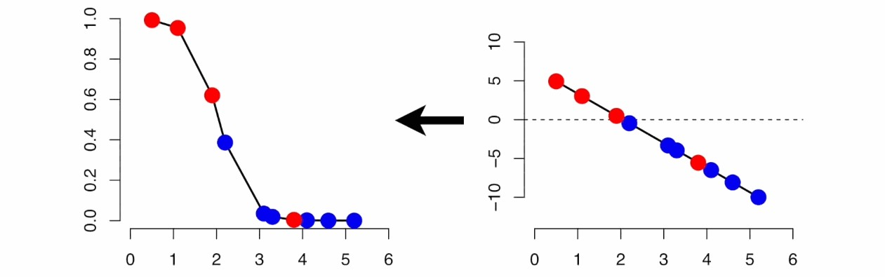
CONTENTS
Linear and Logistic Regression
Linear Regression is similar to Logistic Regression but different.
Linear Regression assumes that there is a linear relationship between dependent and independent variables. It uses the line of best fit that describes two or more variables. The aim of Linear Regression is to accurately predict the output for the continuous dependent variable.
However, Logistic regression predicts the probability of an event or class that is dependent on other factors, therefore the output of Logistic Regression always lies between 0 and 1.

Slide 49
CONTENTS
Cost Function
A Cost Function is a mathematical formula used to calculate the error, it is a difference between our predicted value and the actual value. It simply measures how wrong the model is in terms of its ability to estimate the relationship between x and y.
The value of the Cost Function can also be referred to as cost, loss, or error. Within Logistic Regression, the Cost Function we use is called Cross-Entropy, also known as Log Loss. The formula for this is:
If you would like to know more about different types of Cost Functions, click on this link.

Slide 50
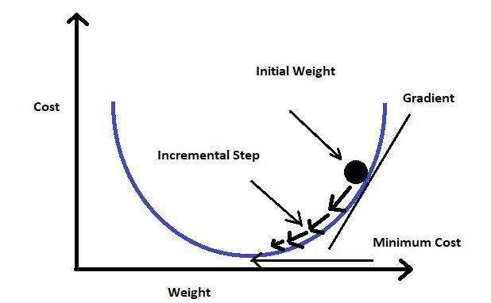
CONTENTS
Gradient Descent
In order to minimize our cost, we use Gradient Descent which estimates the parameters or weights of our model.

Slide 51
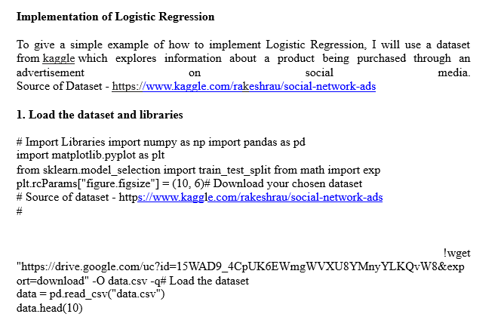
CONTENTS

Slide 52
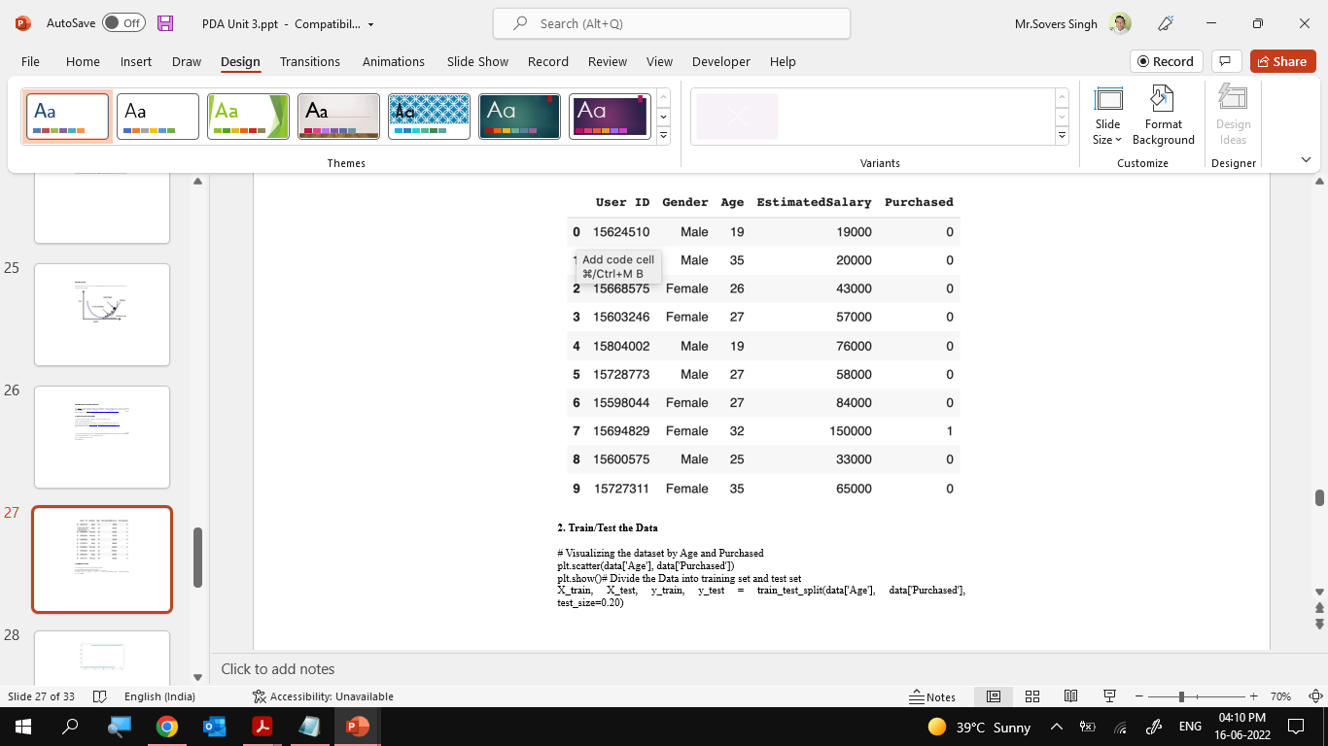
CONTENTS

Slide 53
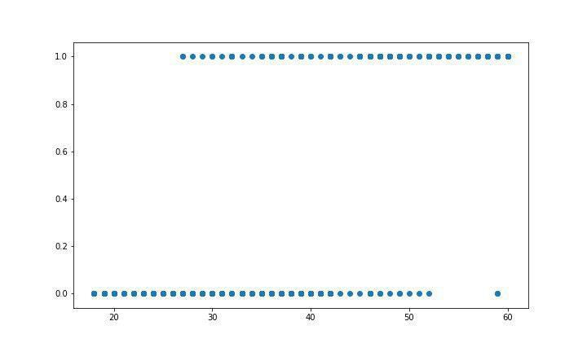
CONTENTS

Slide 54
CONTENTS
3. Building the Model
We will need to normalise the data as well as shifting the mean to the origin. This is due to wanting to get accurate results because of the nature of the Logistic Equation. We then create a method that will help us make predictions, which will return a probability. We can then move onto training the model. The model is trained for 300 epochs and The partial derivatives are calculated at each of these 300 epochs and the weights are updated.
# Building the Logistic Regression model
# Normalising the data def normalize(X): return X - X.mean()
# Make predictions def predict(X, b0, b1):
return np.array([1 / (1 + exp(-1*b0 + -1*b1*x)) for x in X])
# The model
def logistic_regression(X, Y):
X = normalize(X)
# Initializing variables b0 = 0
b1 = 0
L = 0.001
epochs = 300
for epoch in range(epochs): y_pred = predict(X, b0, b1)
D_b0 = -2 * sum((Y - y_pred) * y_pred * (1 - y_pred)) # Loss wrt b0 D_b1 = -2 * sum(X * (Y - y_pred) * y_pred * (1 - y_pred)) # Loss wrt b1
# Update b0 and b1 b0 = b0 - L * D_b0 b1 = b1 - L * D_b1
return b0, b1

Slide 55
CONTENTS
4. Training the Model
As mentioned above, the prediction equation will return a probability. Because this is a classification task, we will need to convert it into a binary value. In order to do this, we need to select a threshold. In this example, we will select the threshold 0.5 which means all the predicted values above 0.5 will be treated as 1 and everything below 0.5 will be treated as 0. You can also calculate the accuracy by checking how many correct predictions we made and dividing it by the total number of test cases.
# Training the Model
b0, b1 = logistic_regression(X_train, y_train)# Making predictions and setting a thresholdX_test_norm = normalize(X_test)
y_pred = predict(X_test_norm, b0, b1) y_pred = [1 if p >= 0.5 else 0 for p in y_pred]
# Plotting the data plt.scatter(X_test, y_test) plt.scatter(X_test, y_pred, c="red")
plt.show()# Calculating the accuracy accuracy = 0
for i in range(len(y_pred)): if y_pred[i] == y_test.iloc[i]: accuracy += 1
print(f"Accuracy = {accuracy / len(y_pred)}")

Slide 56
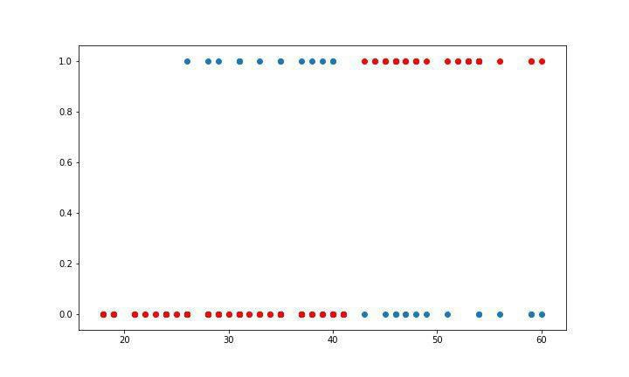
CONTENTS
Plot and Accuracy:
Accuracy = 0.85

Slide 57
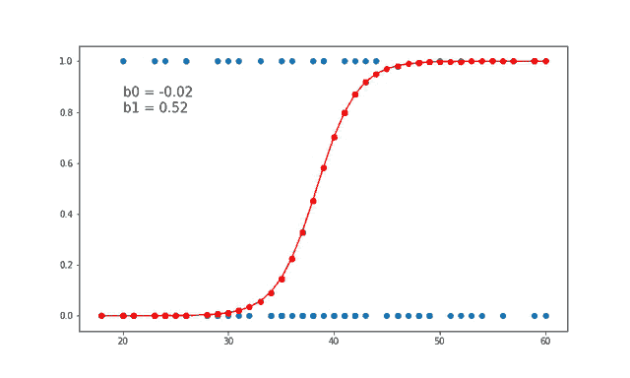
CONTENTS
Using this below gify helps us to visually see how the value of weights b0 and b1 are updated at each iteration.

Slide 58
CONTENTS
Conclusion
Logistic Regression is a widely used technique due to it being very efficient and not requiring a lot of computational resources. Logistic regression works more efficiently when you remove variables that have no or little relation to the output variable. Therefore, feature engineering is an important element in the performance of Logistic Regression.
Logistic Regression is very good for classification tasks, however, it is not one of the most powerful algorithms out there. It can be easily outperformed by other more complex algorithms, however it is easy and simple to work with. However, due to its simplicity, it can be used as a good baseline to compare with the performance of other more complex algorithms.

Slide 59
Logistic Regression in classification
Objective:
In this topic we learn Logistic regression which is a supervised learning classification algorithm used to predict the probability of a target variable. The nature of target or dependent variable is dichotomous, which means there would be only two possible classes.
Recap:
Revision of basic statistical approaches.

Slide 60
Logistic Regression in classification
Introduction to Logistic Regression
Logistic regression is a supervised learning classification algorithm used to predict the probability of a target variable. The nature of target or dependent variable is dichotomous, which means there would be only two possible classes.
In simple words, the dependent variable is binary in nature having data coded as either 1 (stands for success/yes) or 0 (stands for failure/no).
Mathematically, a logistic regression model predicts P(Y=1) as a function of X. It is one of the simplest ML algorithms that can be used for various classification problems such as spam detection, Diabetes prediction, cancer detection etc.
Types of Logistic Regression
Generally, logistic regression means binary logistic regression having binary target variables, but there can be two more categories of target variables that can be predicted by it. Based on those number of categories, Logistic regression can be divided into following types −
Binary or Binomial
In such a kind of classification, a dependent variable will have only two possible types either 1 and 0. For example, these variables may represent success or failure, yes or no, win or loss etc.

Slide 61
Logistic Regression in classification
Multinomial
In such a kind of classification, dependent variable can have 3 or more possible unordered types or the types having no quantitative significance. For example, these variables may represent “Type A” or “Type B” or “Type C”.
Ordinal
In such a kind of classification, dependent variable can have 3 or more possible ordered types or the types having a quantitative significance. For example, these variables may represent “poor” or “good”, “very good”, “Excellent” and each category can have the scores like 0,1,2,3.

Slide 62
Logistic Regression in classification
Logistic Regression Assumptions
Before diving into the implementation of logistic regression, we must be aware of the following assumptions about the same −
In case of binary logistic regression, the target variables must be binary always and the desired outcome is represented by the factor level 1.
There should not be any multi-collinearity in the model, which means the independent variables must be independent of each other .
We must include meaningful variables in our model.
We should choose a large sample size for logistic regression.

Slide 63
Logistic Regression in classification
Binary Logistic Regression model
The simplest form of logistic regression is binary or binomial logistic regression in which the target or dependent variable can have only 2 possible types either 1 or 0. It allows us to model a relationship between multiple predictor variables and a binary/binomial target variable. In case of logistic regression, the linear function is basically used as an input to another function such as 𝑔 in the following relation −
Implementation in Python
Now we will implement the above concept of binomial logistic regression in Python. For this purpose, we are using a multivariate flower dataset named ‘iris’ which have 3 classes of 50 instances each, but we will be using the first two feature columns. Every class represents a type of iris flower.
First, we need to import the necessary libraries as follows −

Slide 64
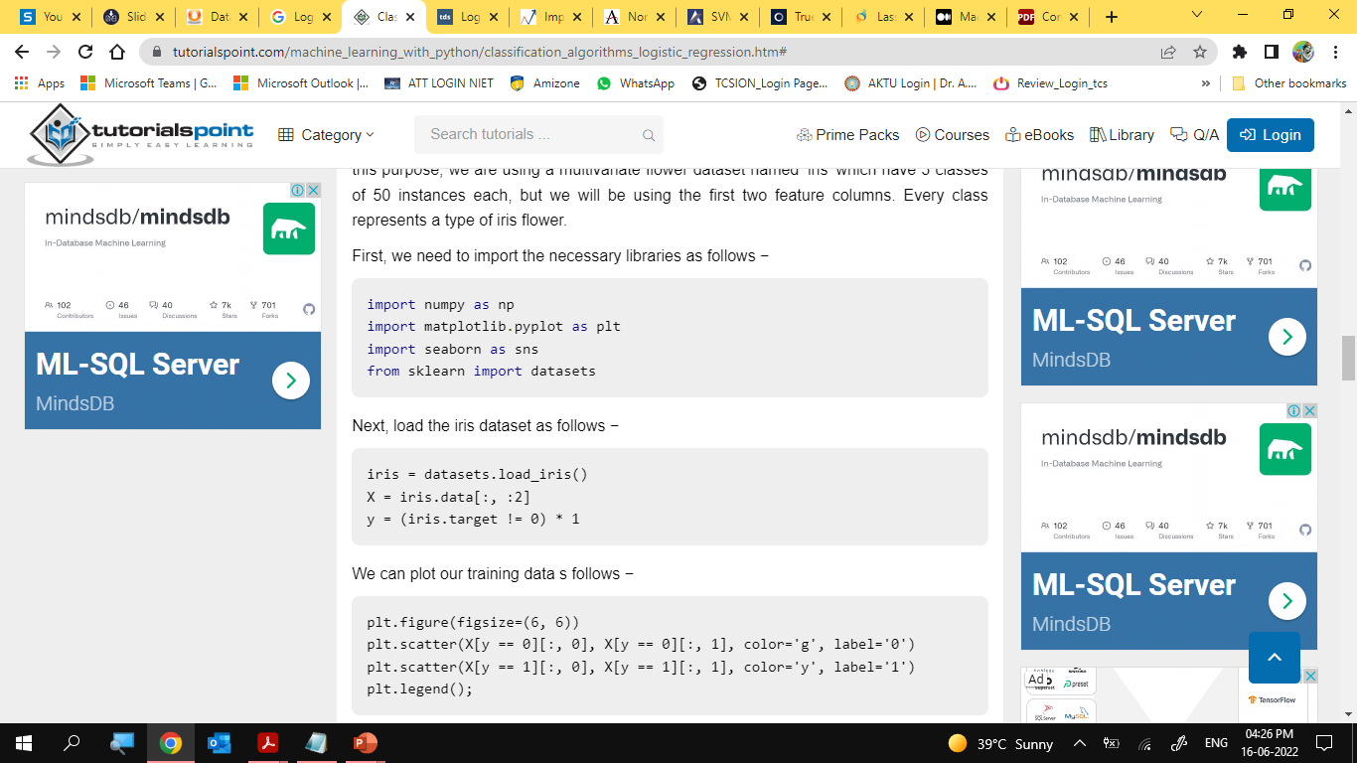
Logistic Regression in classification

Slide 65
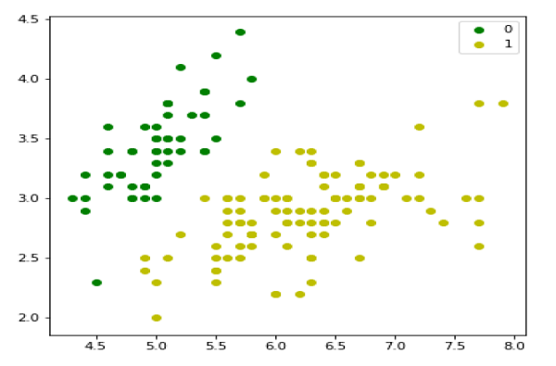
Logistic Regression in classification

Slide 66
Logistic Regression in classification
Next, we will define sigmoid function, loss function and gradient descend as follows −
class LogisticRegression:
def __init__(self, lr=0.01, num_iter=100000, fit_intercept=True, verbose=False):
self.lr = lr
self.num_iter = num_iter
self.fit_intercept = fit_intercept
self.verbose = verbose
def __add_intercept(self, X):
intercept = np.ones((X.shape[0], 1))
return np.concatenate((intercept, X), axis=1)
def __sigmoid(self, z):
return 1 / (1 + np.exp(-z))
def __loss(self, h, y):
return (-y * np.log(h) - (1 - y) * np.log(1 - h)).mean()
def fit(self, X, y):
if self.fit_intercept:
X = self.__add_intercept(X)

Slide 67
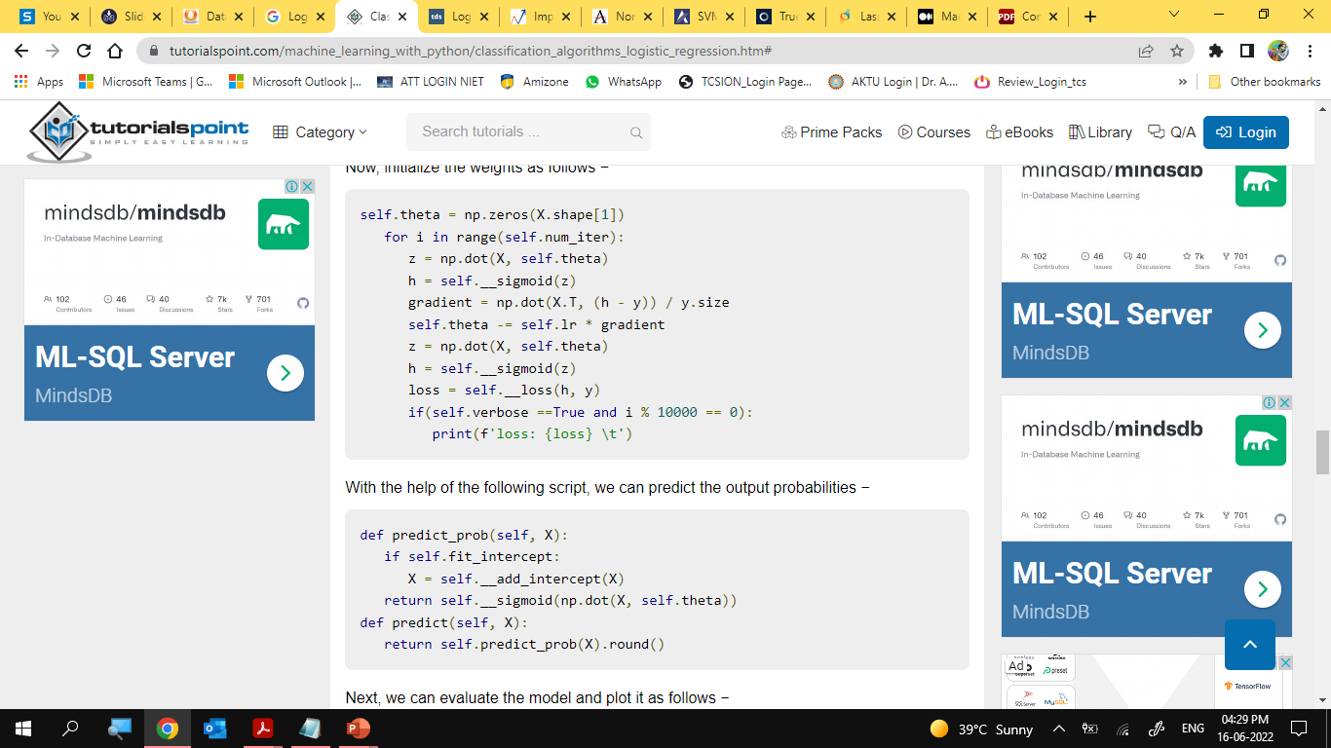
Logistic Regression in classification
Now, initialize the weights as follows −

Slide 68
Logistic Regression in classification
Next, we can evaluate the model and plot it as follows
model = LogisticRegression(lr=0.1, num_iter=300000)
preds = model.predict(X)
(preds == y).mean()
plt.figure(figsize=(10, 6))
plt.scatter(X[y == 0][:, 0], X[y == 0][:, 1], color='g', label='0')
plt.scatter(X[y == 1][:, 0], X[y == 1][:, 1], color='y', label='1')
plt.legend()
x1_min, x1_max = X[:,0].min(), X[:,0].max(),
x2_min, x2_max = X[:,1].min(), X[:,1].max(),
xx1, xx2 = np.meshgrid(np.linspace(x1_min, x1_max), np.linspace(x2_min, x2_max))
grid = np.c_[xx1.ravel(), xx2.ravel()]
probs = model.predict_prob(grid).reshape(xx1.shape)
plt.contour(xx1, xx2, probs, [0.5], linewidths=1, colors='red');

Slide 69
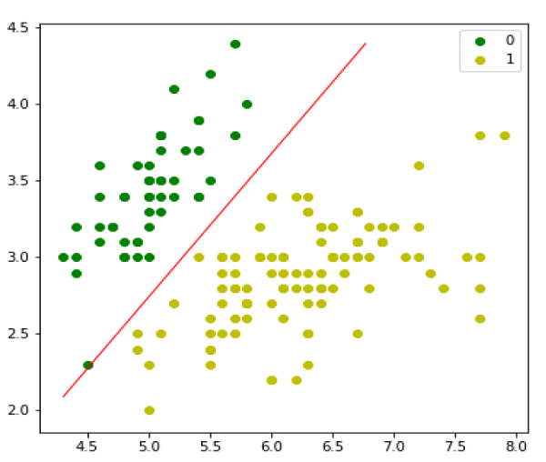
Logistic Regression in classification

Slide 70
Logistic Regression in classification
Multinomial Logistic Regression Model
Another useful form of logistic regression is multinomial logistic regression in which the target or dependent variable can have 3 or more possible unordered types i.e. the types having no quantitative significance.
Implementation in Python
Now we will implement the above concept of multinomial logistic regression in Python. For this purpose, we are using a dataset from sklearn named digit.
First, we need to import the necessary libraries as follows −

Slide 71
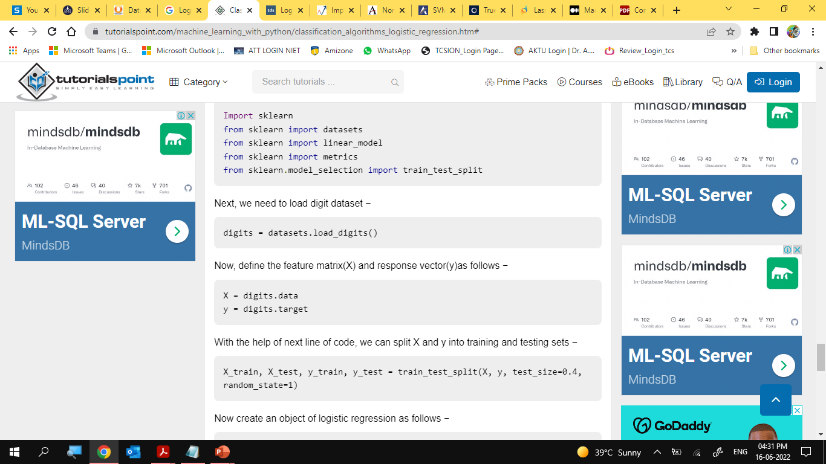
Logistic Regression in classification

Slide 72
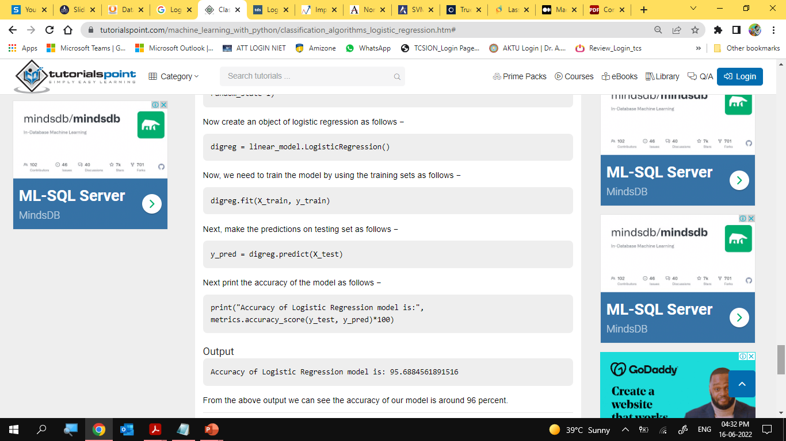
Logistic Regression in classification

Slide 73
Data-Set Links for Regression
CONTENTS
https://www.telusinternational.com/articles/10-open-datasets-for-linear-regression
https://www.kaggle.com/code/rtatman/datasets-for-regression-analysis/notebook
https://archive.ics.uci.edu/ml/datasets.php?format=&task=reg&att=&area=&numAtt=&numIns=&type=&sort=nameUp&view=table

Slide 74
Daily Quiz
Is logistic regression a generative or a descriptive classifier? Why?
Can you use logistic regression for classification between more than two classes?
How do you implement multinomial logistic regression?
Suppose that you are trying to predict whether a consumer will recommend a particular brand of chocolate or not. Let us say your hypothesis function outputs h(x)=0.55 where h(x) is the probability that y=1 (or that a consumer recommends the chocolate) given any input x. Does this mean that the consumer will recommend the chocolate?
Why can't we use the mean square error cost function used in linear regression for logistic regression?
If you observe that the cost function decreases rapidly before increasing or stagnating at a specific high value, what could you infer?
What alternative could you suggest using a for loop (which is time-consuming) when using Gradient Descent to find the optimum parameters for logistic regression?
Are there alternatives to find optimum parameters for logistic regression besides using Gradient Descent?
How many binary classifiers would you need to implement one-vs-all for three classes? How does it work?
How many binary classifiers would you need to implement one-vs-one for four classes? How does it work?

Slide 75
Weekly/monthly/Unit Wise Assignment.
Assignment
What is the importance of regularization?
Why is the Wald Test useful in logistic regression but not in linear regression?
Will the decision boundary be linear or non-linear in logistic regression models? Explain with an example.
What are odds? Why is it used in logistic regression?
Given fair die, what are the odds of occurrence of odd numbers?
In classification problems like logistic regression, classification accuracy alone is not considered a good measure. Why?
It is common practice that when the number of features or independent variables is larger in comparison to the training set, it is common to use logistic regression or support vector machine (SVM) with a linear kernel. What is the reasoning behind this?
Between SVM and logistic regression, which algorithm is most likely to work better in the presence of outliers? Why?
Which is the most preferred algorithm for variable selection?
What according to you is the method to best fit the data in logistic regression?

Slide 76
Faculty Video Links, You tube & NPTEL Video Links and Online Courses Details
You Tube video
(1) Predictive Analytics Tutorial | Linear Regression in Python | Logistic Regression | Great Learning - YouTube
(2) Multiple Regression Analysis: Hypothesis Tests - YouTube
(3) Mod-06 Lec-28 Goodness of Fit - YouTube

Slide 77
MCQ unit wise/weekly
1. Logistic regression is used when you want to:
Predict a dichotomous variable from continuous or dichotomous variables.
Predict a continuous variable from dichotomous variables.
Predict any categorical variable from several other categorical variables.
Predict a continuous variable from dichotomous or continuous variables.
2. The odds ratio is:
The ratio of the probability of an event not happening to the probability of the event happening.
The probability of an event occurring.
The ratio of the odds after a unit change in the predictor to the original odds.
The ratio of the probability of an event happening to the probability of the event not happening.
3. Large values of the log-likelihood statistic indicate:
That there are a greater number of explained vs. unexplained observations.
That the statistical model fits the data well.
That as the predictor variable increases, the likelihood of the outcome occurring decreases.
That the statistical model is a poor fit of the data.

Slide 78
MCQ unit wise/weekly
4. Logistic regression assumes a:
Linear relationship between continuous predictor variables and the outcome variable.
Linear relationship between continuous predictor variables and the logit of the outcome variable.
Linear relationship between continuous predictor variables.
Linear relationship between observations.
5. In binary logistic regression:
The dependent variable is continuous.
The dependent variable is divided into two equal subcategories.
The dependent variable consists of two categories.
There is no dependent variable.

Slide 79
Glossary Questions
1. A significance test on the slope coefficient using the t ratio tests the hypothesis that the slope is equal to zero.
a. True
b. False
2. If the absolute value of the t ratio is larger than the t value taken from the table, then the conclusion is that the slope does not differ from zero.
a. True
b. False
3. A t test on the slope takes, as its alternative hypothesis, the position that there is no relationship between the dependent variable and the relevant independent variable.
a. True
b. False
4. For a given sample size, the more independent variables are incorporated in a regression model, the more degrees of freedom the relevant t distribution has.
a. True
b. False
5. The significance level of a t test on the slope of a simple linear regression equation measures the probability of drawing an incorrect conclusion when the test indicates that X and Y have a significant relationship.
a. True
b. False

Slide 80

Semester Paper

Slide 81
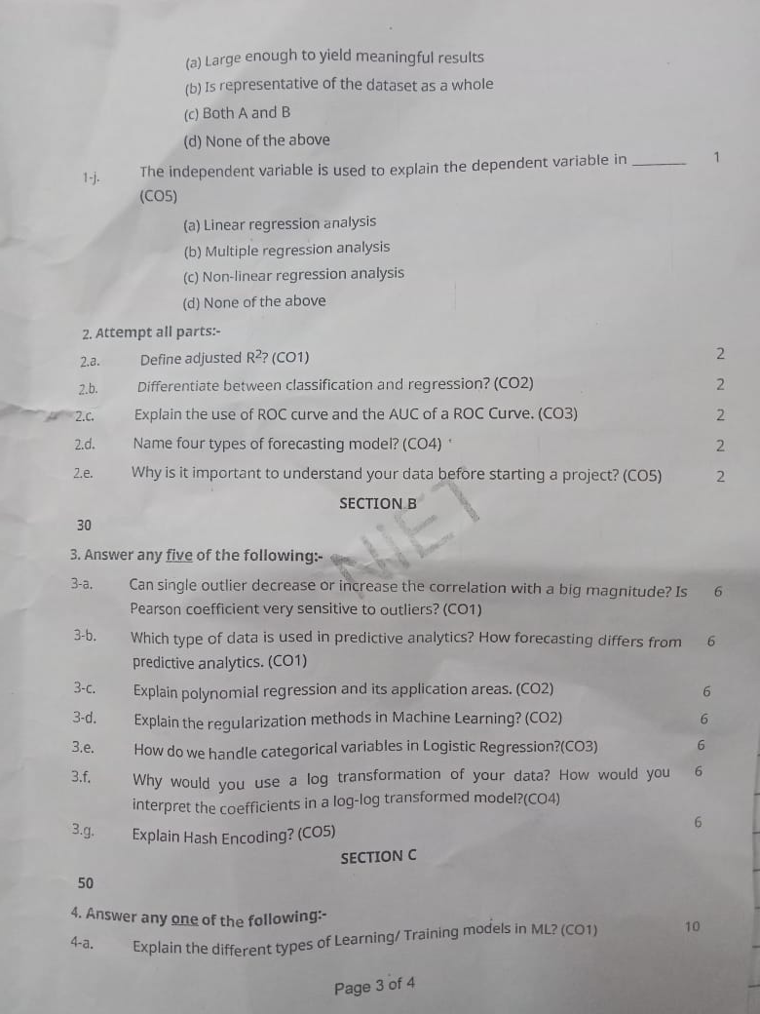
Semester Paper

Slide 82
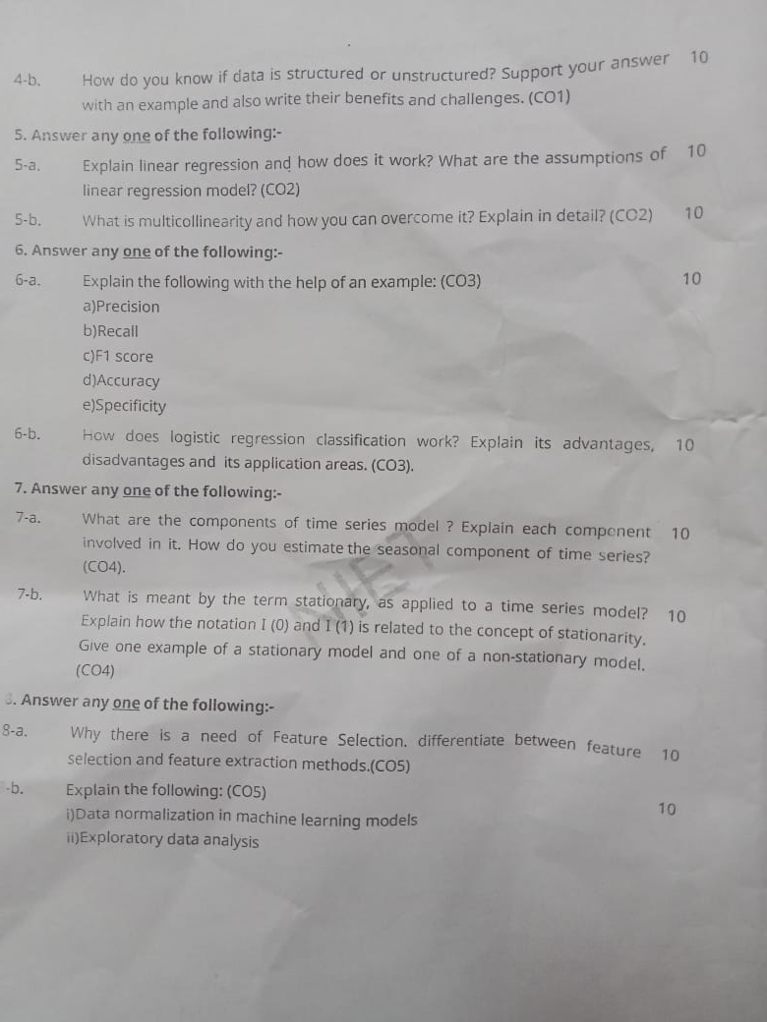
Semester Paper

Slide 83

Semester Paper

Slide 84
Expected Questions for University Exam
What are the difference between linear regression and logistic?
What are the analytical challenges during model development?
What is stepwise selection method?
What are the assumptions of linear regression?
How do you penalize the model for extra variables?
What is the method of maximum likelihood?
What are the key matrices used to check the performance of logistic regression?
How do you handling missing values?
What is multi-colinearity?
How do you remove variable redundancy?
What is the issue of high dimensionality?

Slide 85
References
Text books
1. Dean Abbott ,“Applied Predictive Analytics Principles and Techniques for the Professional DataAnalyst” , Wiley.
2. “Fundamentals of Machine Learning for Predictive Data Analytics” By John D. Kelleher, Brian Mac Namee and Aoife D'Arcy
3. Predictive & Advanced Analytics (IBM ICE Publication)
Reference Books
1. “An Introduction to Statistical Learning: with Applications in R” by James, Witten, Hastie and Tibshirani, Springer, 1st. Edition, 2013.
2.“R for Everyone: Advanced Analytics and Graphics” by Lander, J., Addison-Wesley Data & Analytics Series, 1 edition, 2013.
3.Sandeep Rakshit, R for Beginners, McGraw Hill (2017).

Slide 86
Recap
This unit provide us fundamentals domain of Data Science and its latest trends in industry.
In this unit we are also benefitted with the knowledge of different types of data and very important is the implementation of machine learning and also through the concept model building which is used in industry prospects.
This unit will impart us with knowledge of business analytics and tolls used in data science.

Slide 87
CONTENTS
Thank You

